Slide 2
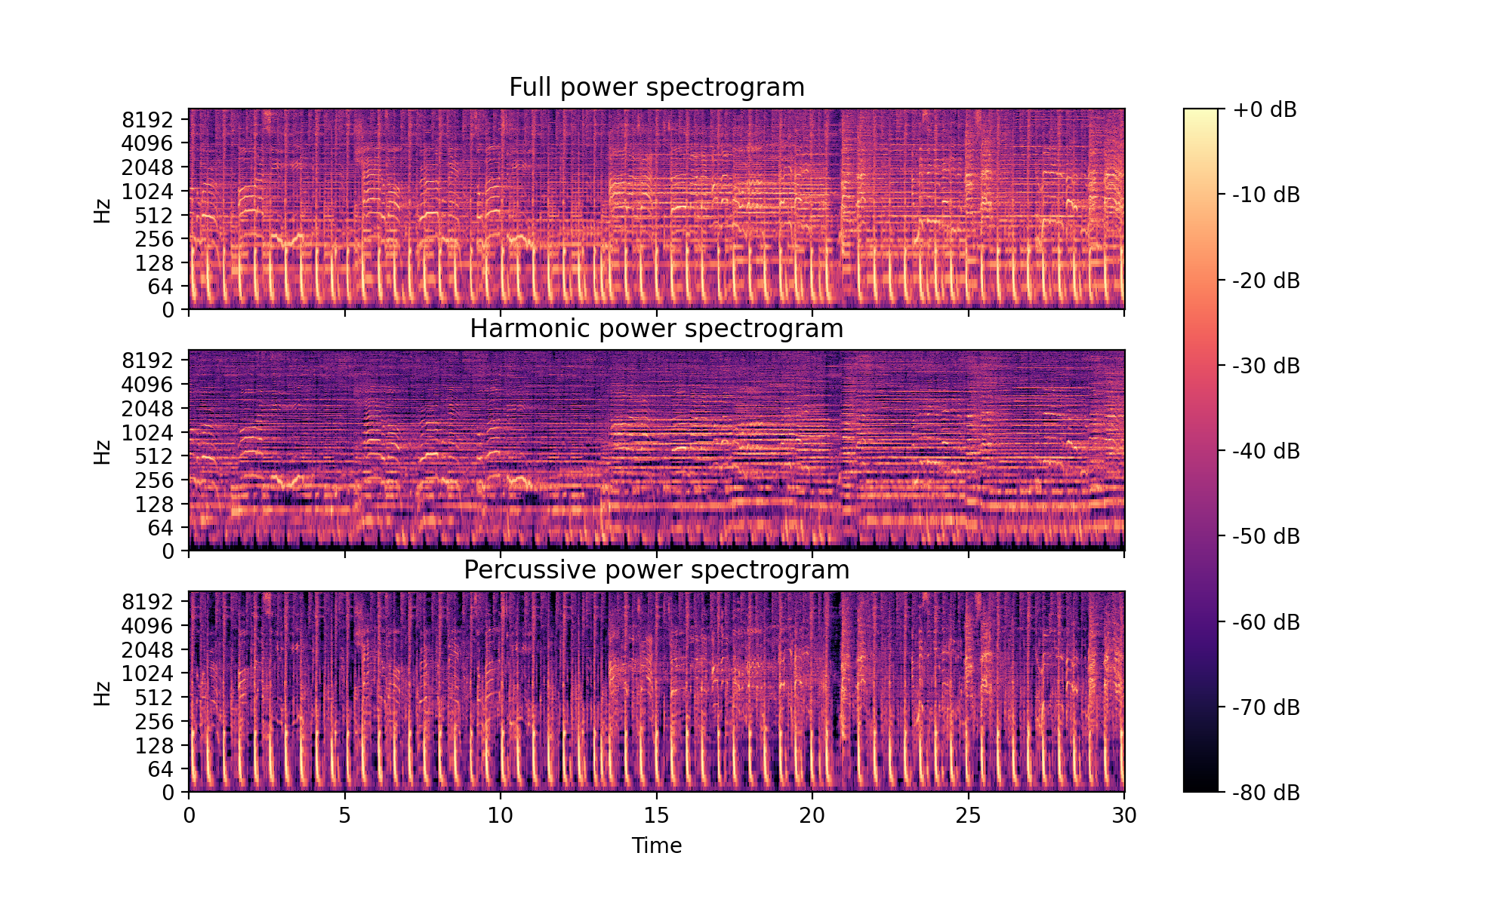
Harmonic Percussive Source Separation
Split melodic and rythmic elements
Derry FitzGerald Proc. of the 13th Int. Conference on Digital Audio Effects (DAFx-10) (2010)

Slide 3
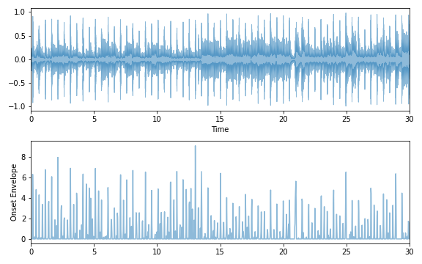
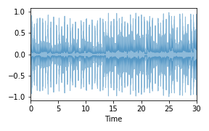
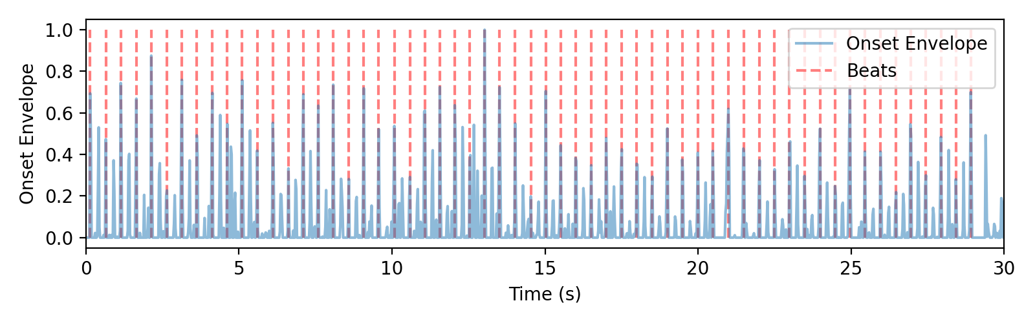
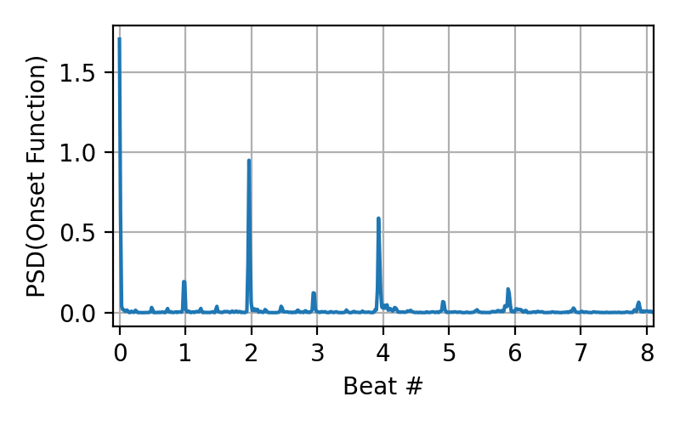
Rythmic variables
Waveform
Onset envelope: measure of dynamics of audio
Tempo
onBeat
Overlap, also Early and Late
Synco
Onset (med slag indikeret)
Waveform
Onset (med slag indikeret)

Slide 4
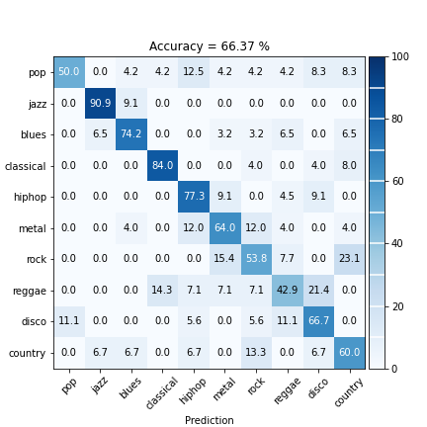
Performance with new variables
LightGBM Classifier (log loss)
Data split Train:Val:Test =70:10:20
Hyper parameter optimization (GridSearch with 5CV)
Including all 41 variables

Slide 5
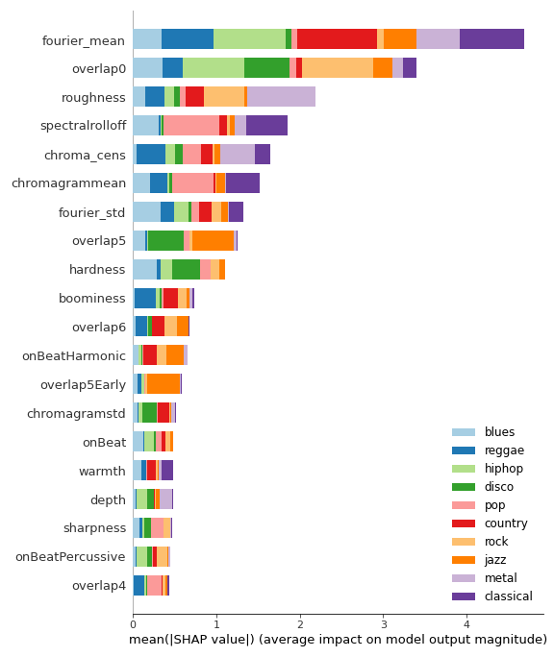
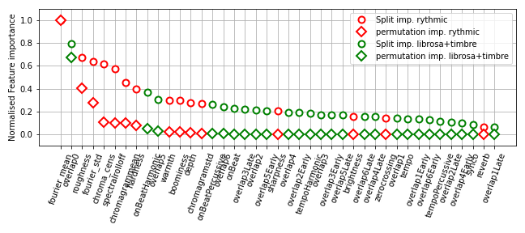
Feature importance
Permutation and split importance
SHAP values
… Homemade features are competitive!

